Slide 1
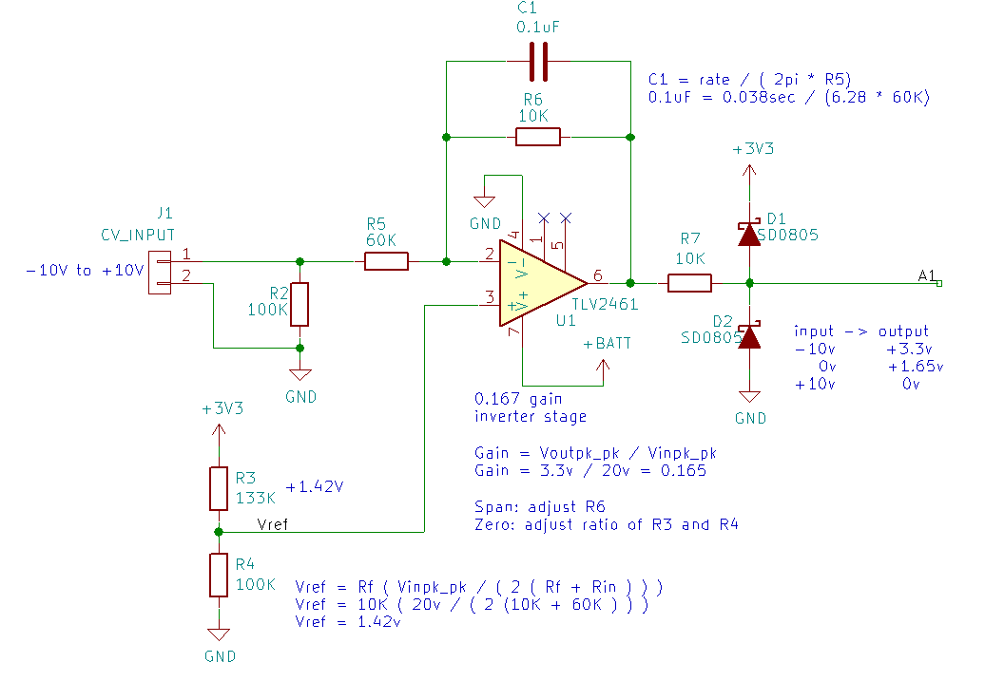
+3.3v
output
to DAC
+1.65
0v
-10v
0v
+10v
CV input

